Slide 1
Clock Skew and Clock Domains

Slide 2
Outline
Why synchronous?
Clock distribution network and skew
Multiple-clock system
Meta-stability and synchronization failure
Synchronizer

Slide 3
1. Review: Why synchronous

Slide 4
Timing of a combinational digital system
Steady state
  Signal reaches a stable value
  Modeled by Boolean algebra
Transient period
  Signal may fluctuate
  No simple model
Propagation delay: time to reach the steady state

Slide 5
Timing Hazards
Hazards: the fluctuation occurring during the transient period
  Static hazard: glitch when the signal should be stable
  Dynamic hazard: a glitch in transition
Due to the multiple converging paths of an output port

Slide 6
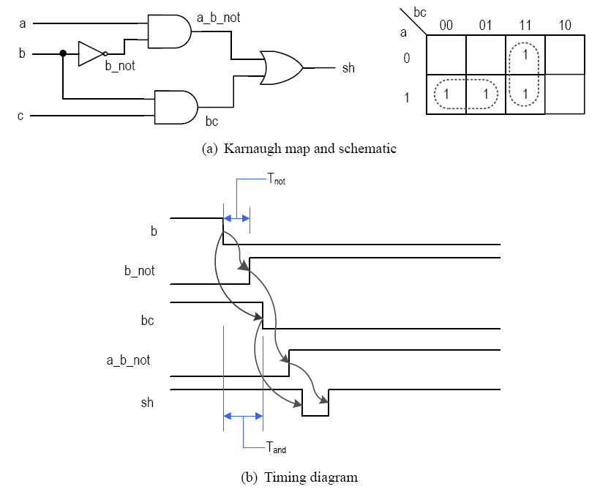
E.g., static-hazard (sh=ab’+bc; a=c=1)

Slide 7
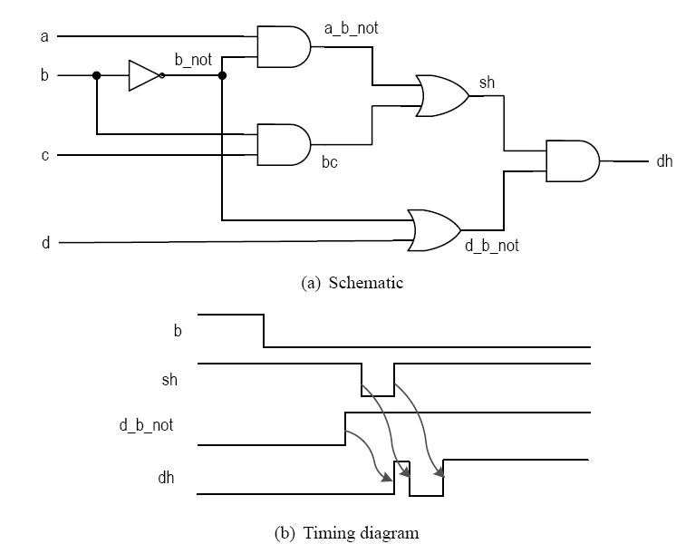
E.g., dynamic hazard (a=c=d=1)

Slide 8
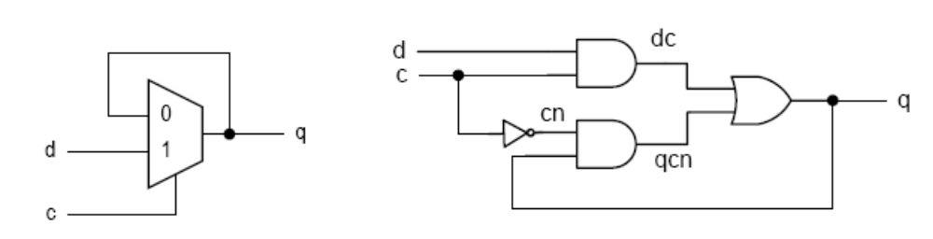
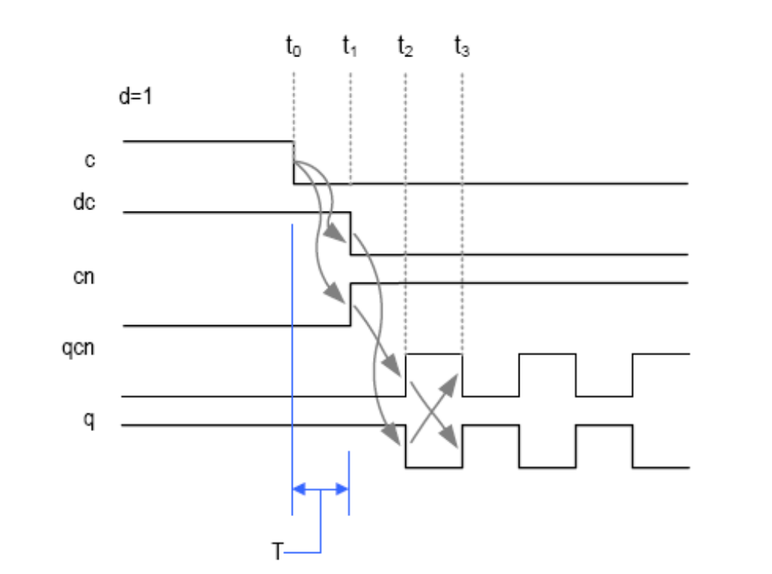

Slide 9
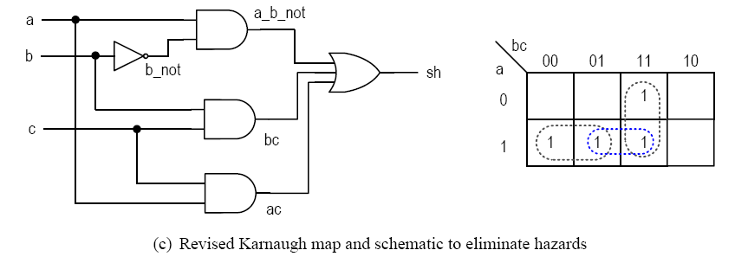
Dealing with hazards
In a small number of cases, additional logic can be added to eliminate race (and hazards).

Slide 10
This is not feasible for synthesis
What’s can go wrong:
  During logic synthesis, the logic expressions will be rearranged and optimized.
  During technology mapping, generic gates will be re-mapped
  During placement & routing, wire delays may change
  It is bad for testing verification

Slide 11
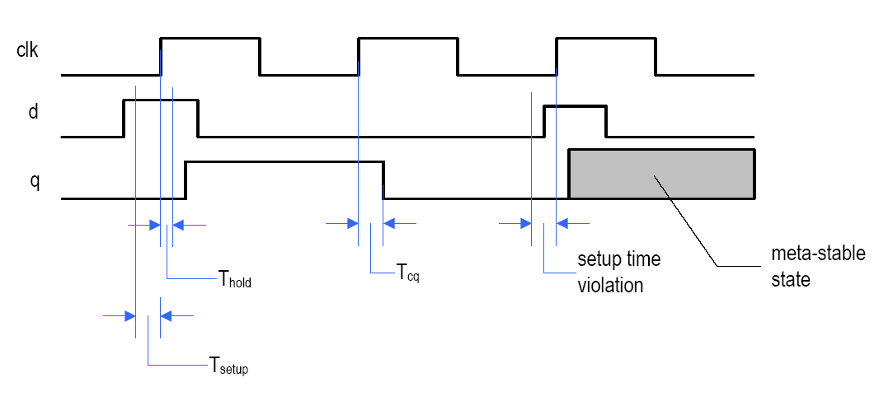
Better way to handle hazards
  Ignore glitches in the transient period and retrieve the data after the signal is stabilized
In a sequential circuit
  Use a clock signal to sample the signal and store the stable value in a register.
  But register introduces new timing constraint (setup time and hold time)

Slide 12
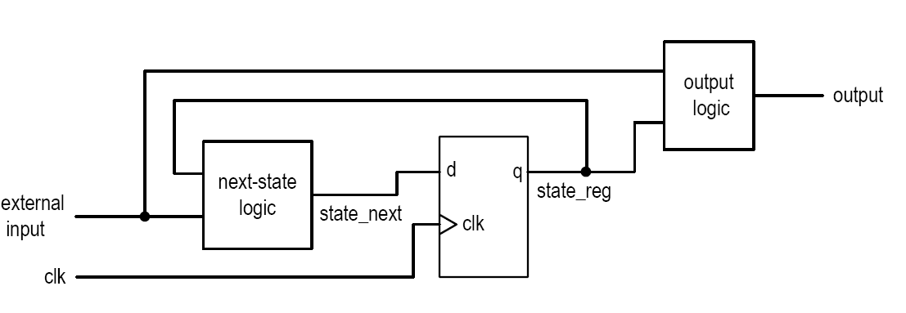
Synchronous system:
  group registers into a single group and drive them with the same clock
  Timing analysis for a single feedback loop

Slide 13
2. Clock distribution network and skew

Slide 14
Clock distribution network
Ideal clock: clock’s rising edges arrive at FFs at the same time
Real implementation:
  Driving capability of each cell is limited
  Need a network of buffers to drive all FFs
  In ASIC: done by clock synthesis (a step in physical synthesis)
  In FPGA: pre-fabricated clock distribution network

Slide 15
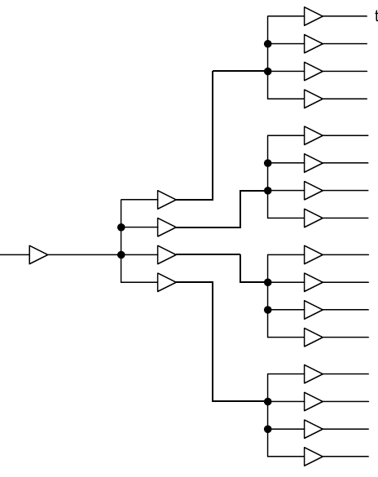
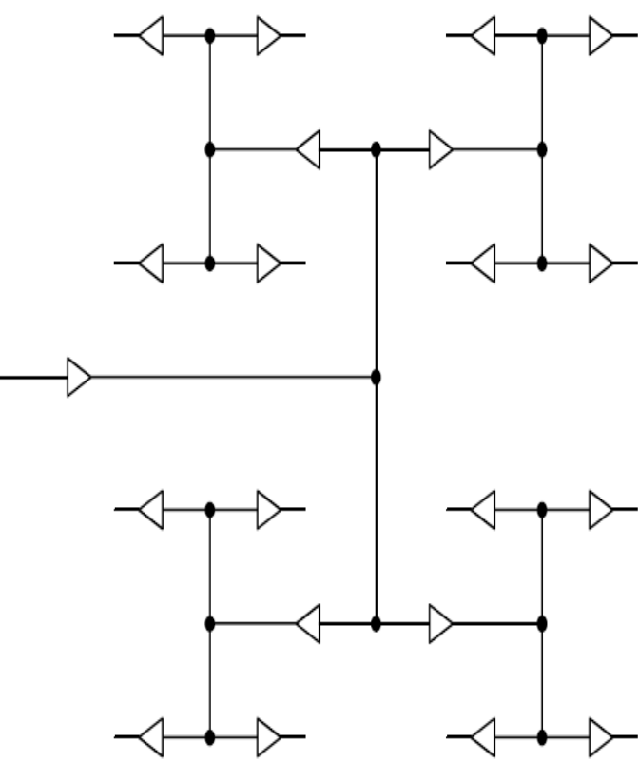
Block diagram
Ideal H-routing

Slide 16
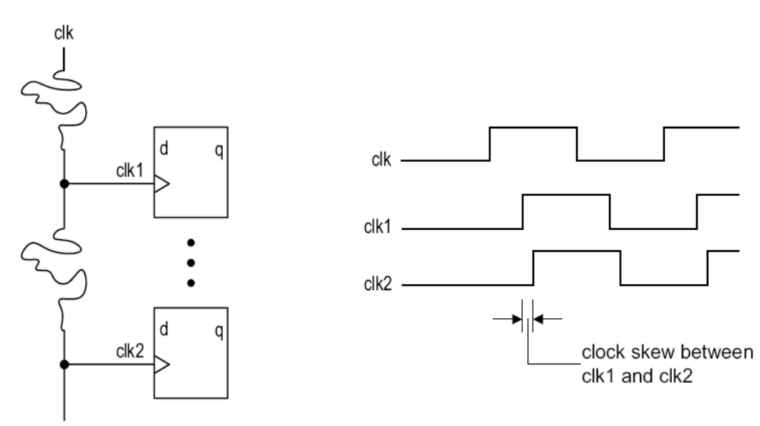
Clock skew
Skew: time difference between two arriving clock edges

Slide 17
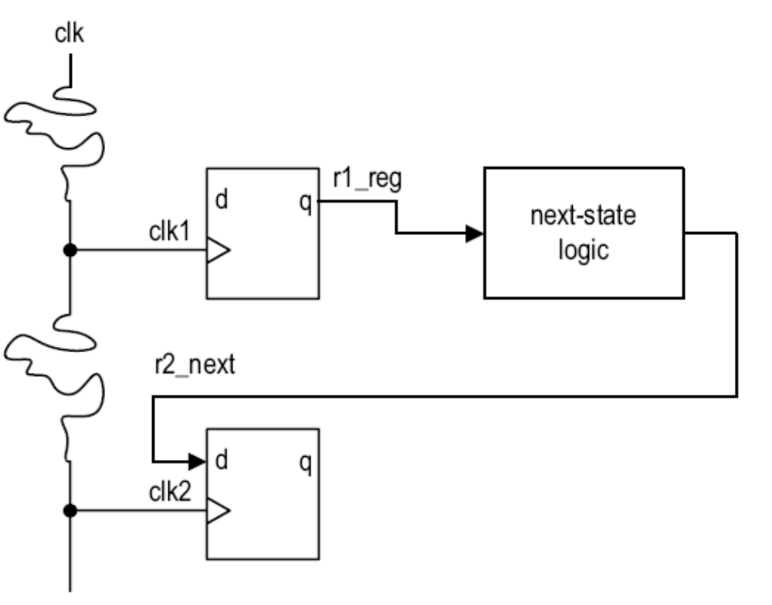
Timing analysis
Setup time constraint (impact on max clock rate)
Hold time constraint

Slide 18
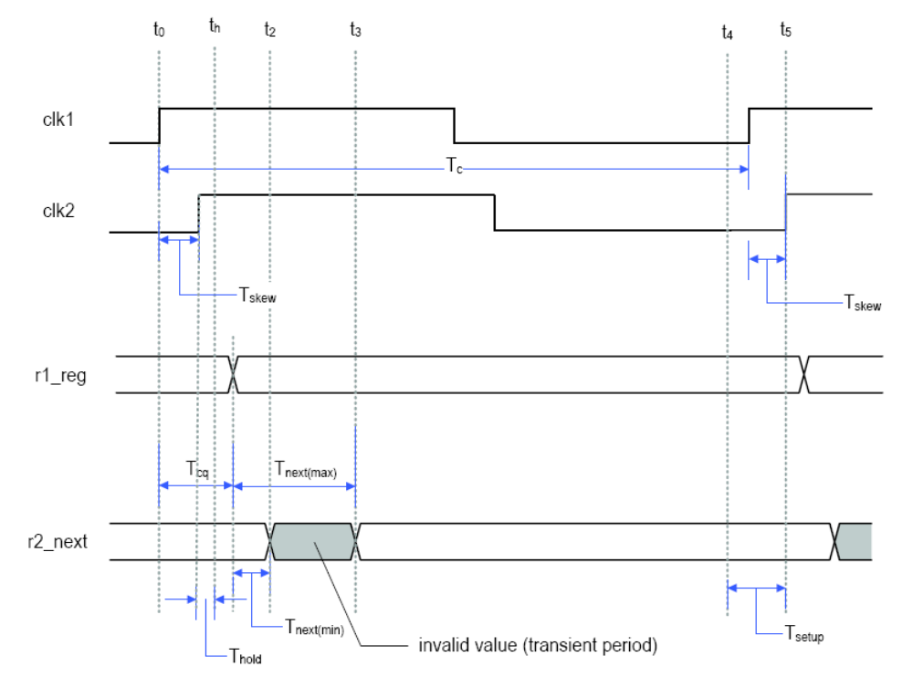

Slide 19
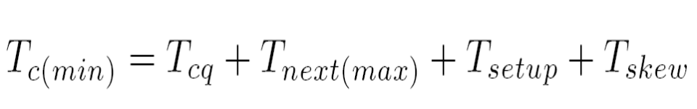
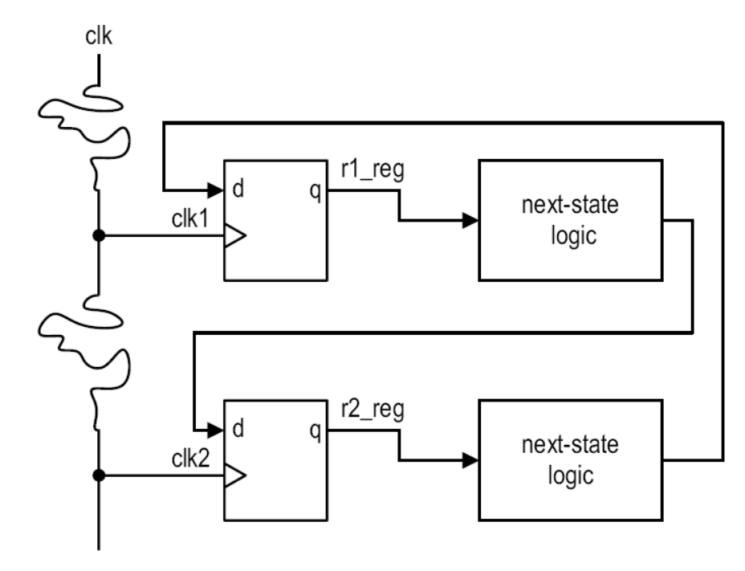
If the clock signal travels from the opposite direction
Normally we have to consider the worst case since
  No control on clock routing during synthesis
  Multiple feedback paths

Slide 20
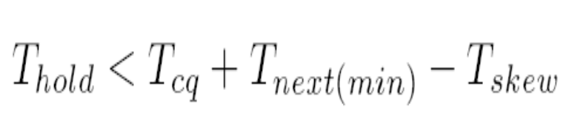
Hold time constraint
Skew may reduce hold time margin

Slide 21
Global and Local Clocks
Global clocks use dedicate routing
  Therefore there are not many global clocks (a few dozen at most)
  Use them wisely!
  Quartus will automatically assign them to high fanout clocks, you can overrule it
Local clocks use regular routing
  slower and prone to clock skew
  but you can have an unlimited number of them
In general try to have as little clock domains as possible (1 is ideal) and try to only use global clocks if possible.

Slide 22
Summary
  Clock skew normally has negative impact on synchronous sequential circuit
  Effect on setup time constraint: require to increase clock period (i.e., reduce clock rate)
  Effect on hold time constraint: may introduce hold time violation
    Can only be fixed during physical synthesis: re-route clock; re-place register and comb logic; add artificial delay logic

Slide 23
3. Multiple-clock system

Slide 24
Why multiple clocks
Inherent multiple clock sources
  E.g., external communication link
Circuit size
  Clock skew increases with the # FFs in a system
  Current technology can support up to 10^4 FFs
Design complexity
  E.g., as system w/ 16-bit 20 MHz processor, 1-bit 100 MHz serial interface, 1 MHz I/O controller
Power consideration
  Dynamic power proportional to switching freq

Slide 25
Derived vs Independent clocks
Independent clocks:
  Relationship between the clocks is unknown
Derived clocks:
  A clock is derived from another clock signals (e.g., different clock rate or phase)
  Relationship is known
  Logic for the derived clock should be separated from regular logic and manually synthesized (e.g., special delay line or PLL)
  A system with derived clock can still be treated and analyzed as a synchronous system

Slide 26
GALS
Globally asynchronous locally synchronous system
  Partition a system into multiple clock domains
  Design and verify subsystem in same clock domain as a synchronous system
  Design special interface between clock domains

Slide 27
4. Review: Meta-stability and synchronization failure

Slide 29
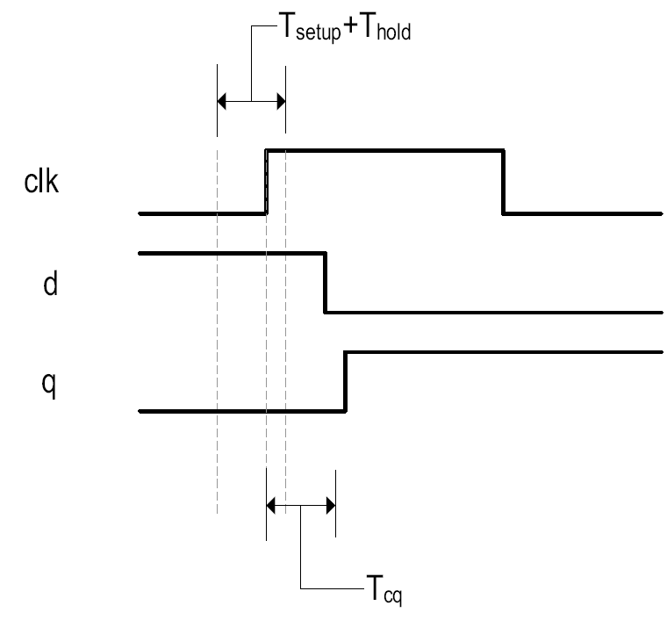
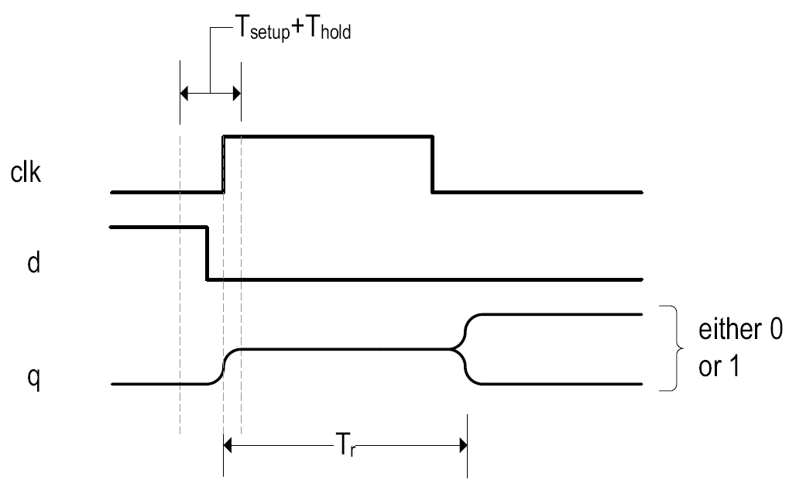
Metastability
What happens after timing violation?

Slide 30
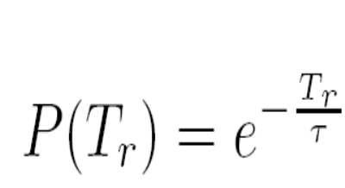
  Output of FF becomes 1 (sampled old input value)
  Output of FF becomes 0 (sampled new input value)
  FF enters metastable state, the output exhibits an “in-between” value
    FF eventually “resolves” to one of stable states
    The resolution time is a random variable with distribution function (τ is decay constant)
    The probability that metastability persists beyond Tr (i.e., cannot be resolved within Tr)

Slide 31
MTBF(Tr)
Synchronization failure
  an FF cannot resolve the metastable condition within the given time
MTBF
  Mean Time Between synchronization Failures
  Basic criterion for metastability analysis
  Frequently expressed as a function of Tr (resolution time provided)

Slide 32
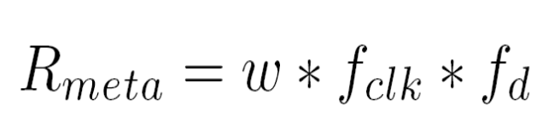
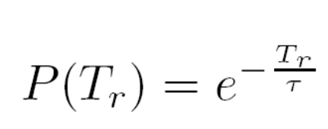
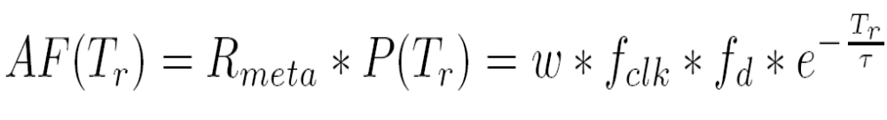
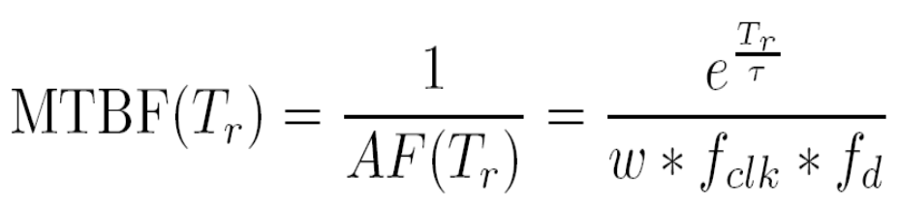
MTBF computation

Slide 33
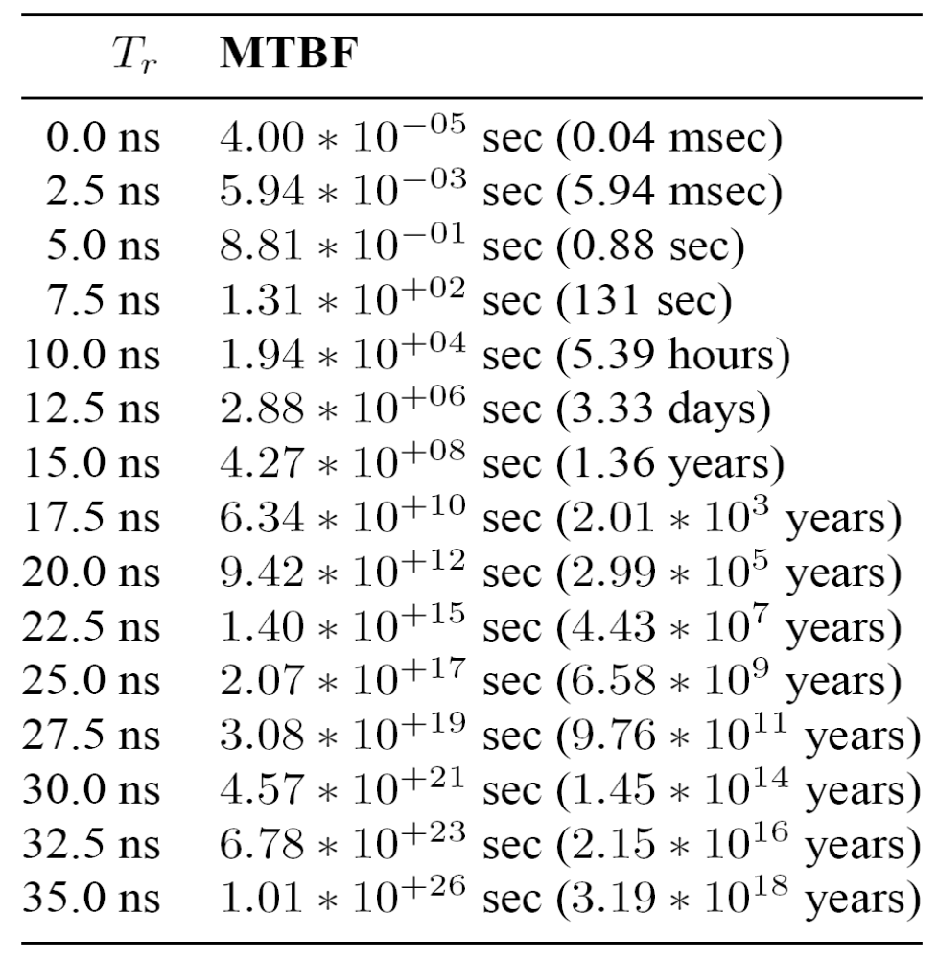
E.g., w=0.1ns, τ=0.5ns, f_{clk}=50MHz, f_{d}=0.1f_{clk}

Slide 34
Observations
  MTBF is statistical average
  Only Tr can be adjusted in practical design
  MTBF is extremely sensitive to Tr
    Good: synchronization failure can be easily avoided by providing additional resolution time
    Bad: minor modification can introduce synchronization failure

Slide 35
5. Review: 1-bit Synchronizers

Slide 36
Synchronization circuit:
  Synchronize an asynchronous input with system clock
  No physical circuit can prevent metastability
  Synchronizer just provides enough time for the metastable condition to be “resolved”
E.g.,
  w=0.1ns, τ=0.5ns, f_{clk}=50MHz, f_{d}=0.1f_{clk}
  T_{setup}=2.5s

Slide 37
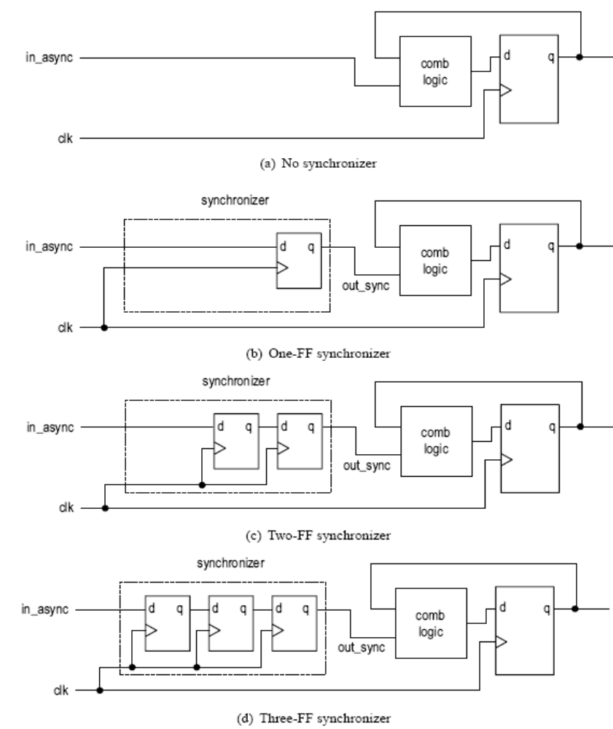

Slide 38
No synchronizer
T_{r} = 0
MTBF(0) = 0.04 ms

Slide 39
One-FF synchronizer
T_{r} = T_{c} – (T_{comb} + T_{setup})
T_{r} depends on T_{c} , T_{setup} and T_{comb}
  T_{c}: vary with system specification
  T_{comb}: vary with circuit, synthesis (gate delay), placement & routing (wire delay)
E.g.,
  T_{r} = 20 – (T_{comb} + 2.5 ) = 17.5 – T_{comb}
  T_{comb} = 1ns, T_{r} = 16.5ns; MTBF(16.5) = 272yr
  T_{comb} = 12.5ns, T_{r} = 5ns; MTBF(5) = 0.88ns
Not a reliable design

Slide 40
Two-FF synchronizer
Add an extra FF to eliminate T_{comb}
  T_{r} = T_{c} – T_{setup}
  T_{r} depends on T_{c} only
  Async input delayed by up to two clock cycles (really a little more than 1 clock cycle)
E.g.,
  T_{r}=20 - 2.5=17.5; MTBF(17.5)=3000yr
Most commonly used synchronizer
In ASIC technology
  May have “metastability-hardened” D FF cell (large area)

Slide 41
Three-FF synchronizer
Add an extra stage to increase resolution time
  T_{r} = 2(T_{c} – T_{setup)} )
  Async input delayed by three clock cycles
E.g.,
  T_{r} =2*(20 - 2.5); MTBF(30)=6 billion yr
Hardly needed

Slide 42
Observation
T_{r} is in the exponent of MTBF equation
Small variation in T_{r} can lead to large swing in MTBF

Slide 43
Proper use of synchronizer
Use a glitch-free signal for synchronization
Synchronize a signal in a single place
Avoid synchronization multiple “related” signals.
Reanalyze the synchronizer after each design change

Slide 44
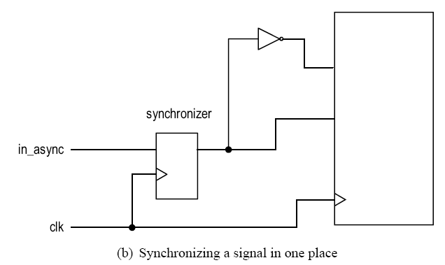
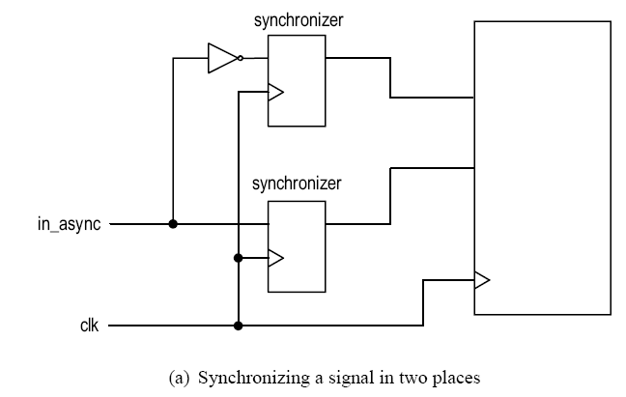

Slide 45
Why synchronization is a “tricky” issue
Metastability is basically an “analog” phenomena
Metastability behavior is described by random variable
Metastability cannot be easily modeled or simulated in gate level (only ‘X’)
Metastability cannot be easily observed or measured in physical circuit (e.g., MTBF = 3 months)
MTBF is very sensitive to circuit revision

Slide 46
6. Enable signal crossing of clock domains

Slide 47
Signals crossing clock domains
Synchronizer
  Just ensures that the receiving system does not enter a metastable state
  Not guarantee the “function” of the received signal
Consideration
  One signal
  Multiple signals (“bundled data”)

Slide 48
Domain-crossing of an enable signal
An enable signal
  One-clock-cycle wide
  To be sample in a single clock edge
  E.g., enable input of a counter; read/write signal of a FIFO buffer
  Can also be used to retrieve bundled data

Slide 49
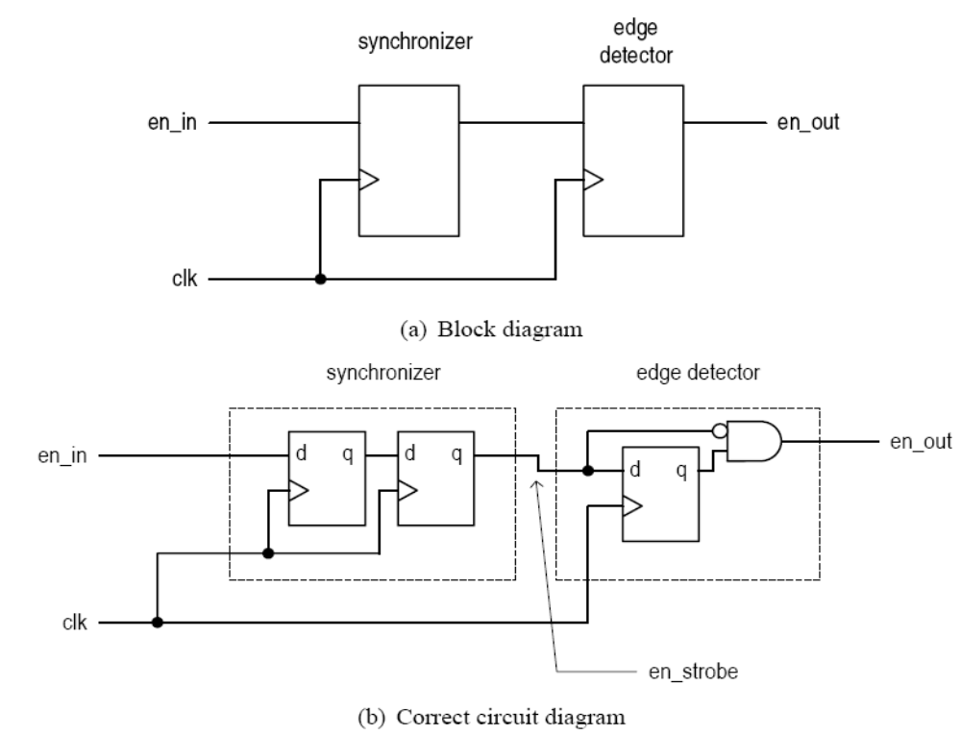
“Wide” enable signal
From a slow clock domain to a fast clock domain (e.g., 1 MHz to 10 MHz)

Slide 50
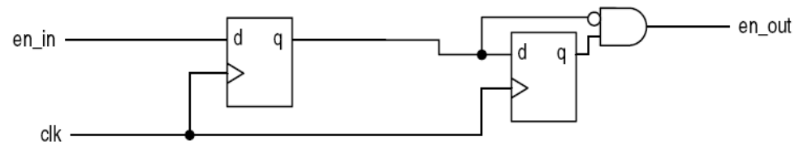
Will this work?

Slide 51
“Narrow” enable signal
From a fast clock domain to a slow clock domain (e.g., 10 MHz to 1 MHz)
The enable pulse is probably too narrow to be detected
Need to “stretch” the pulse
  Cannot be done by a normal sequential circuit
  Need to use “tricks”

Slide 52
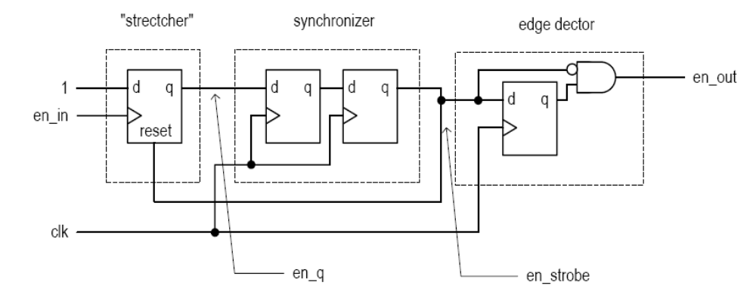
en_q asserted at the rising edge of en_in
en_q then synchronized
en_strobe then clears stretcher
en_q may last over two clock cycles and thus an edge-detector is needed
Can this scheme be used for wide-pulse?

Slide 53
Level-alternating scheme
Output interface of sender and input interface of receiver modified for domain crossing
Output interface converts an “edge-sensitive” enable pulse to a level-alternating signal
  Use a T-FF
Input interface converts the level-alternating signal back to “edge-sensitive” enable pulse
  Use a dual-edge detector
Eliminate the ad-hoc stretcher and follow the synchronous design methodology

Slide 54
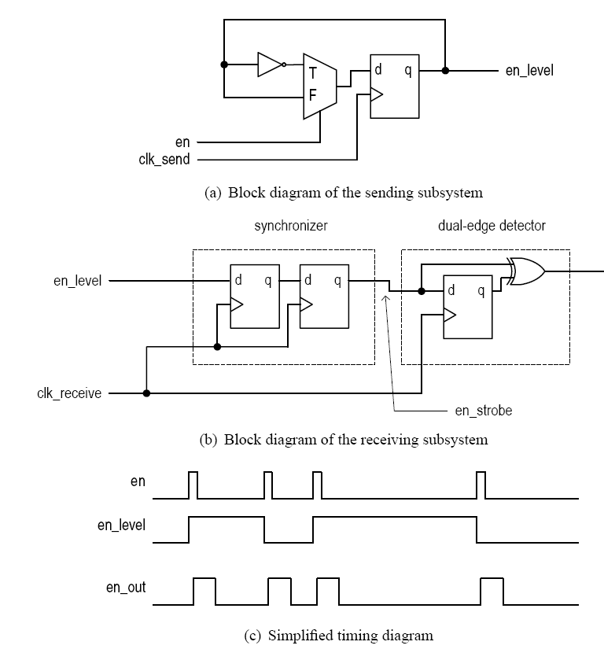

Slide 55
6. Handshaking

Slide 56
How to control the rate of data (or number of enable ticks) between two clock domains? (e.g., 10 MHz system to 1 MHz system)
Does the sending system have prior knowledge about the processing speed of receiving system?
Handshaking scheme
  Use a feedback signal
  Make minimal assumption about the receiving system

Slide 57
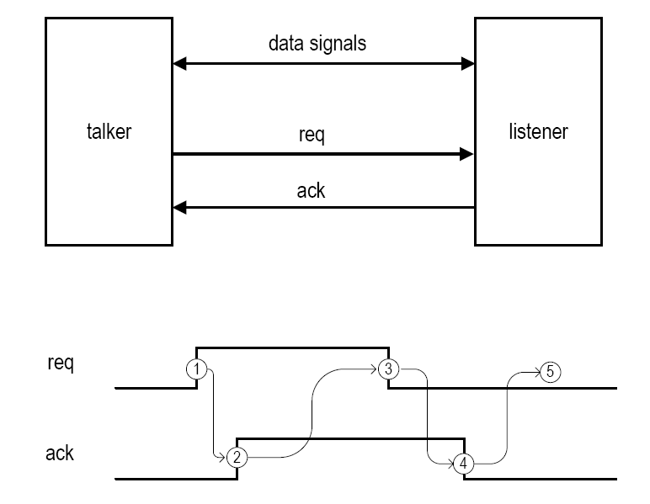

Slide 58
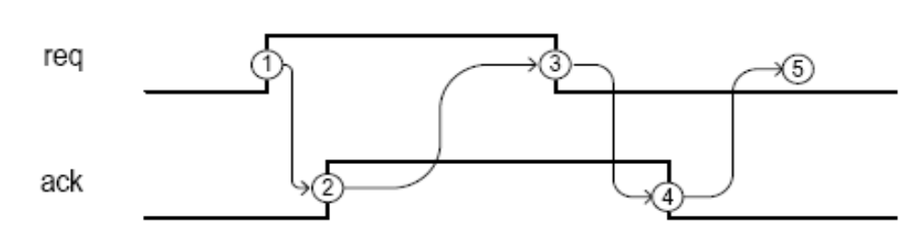
Four phases:
  Phase 1: talker activates req
  Phase 2: listener activates ack
  Phase 3: talker de-activates req
  Phase 4: listener de-activates ack
  Talker can start a new request

Slide 59
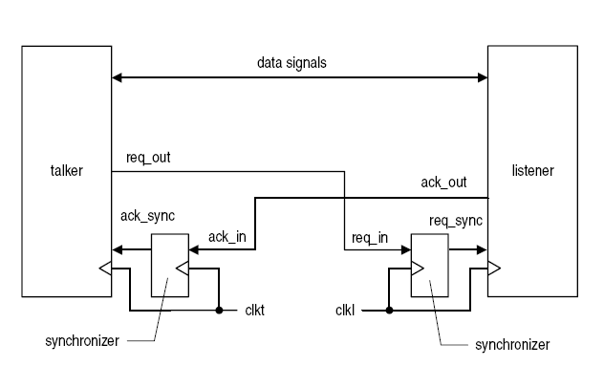
Need synchronizer if talker listener in different clock domains

Slide 60
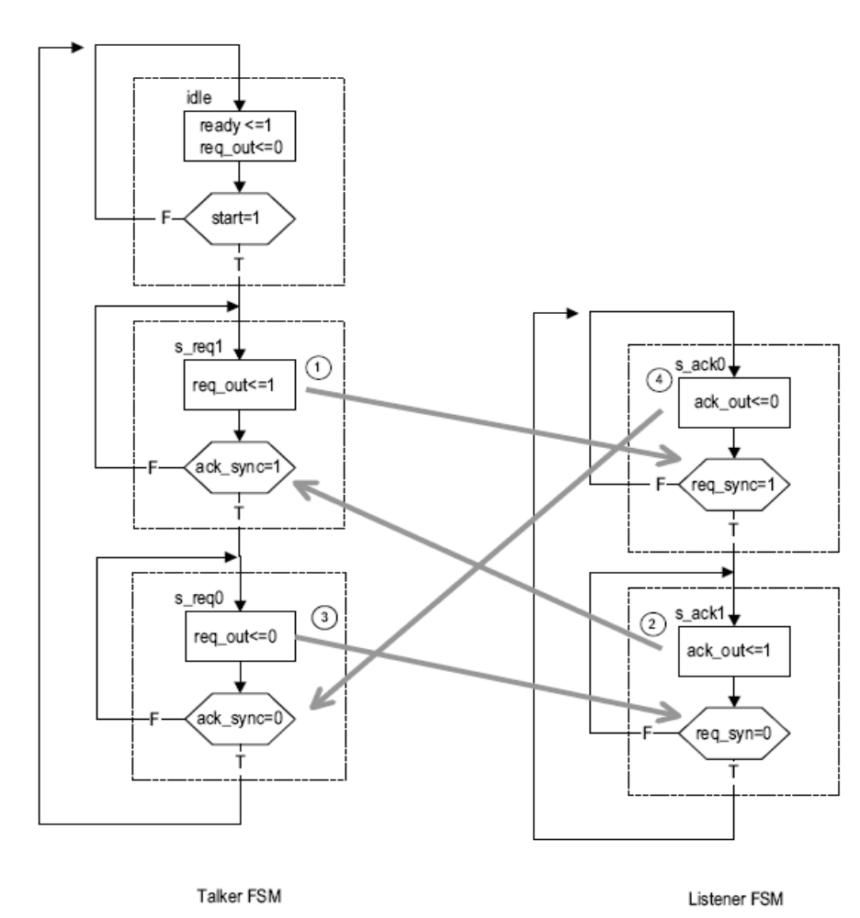
Talker FSM and listener FSM

Slide 61
Implementation:
  Talker: FSM and synchronizer for ack_out
  Listener: FSM and synchronizer for req_out
Pass an enable tick using handshaking
  The enable tick functions as the start signal in talker
  The listener generates a Mealy output which is asserted when req_sync is asserted in the s_ack0 state (i.e., a rising-edge detection circuit for req_sync)

Slide 62
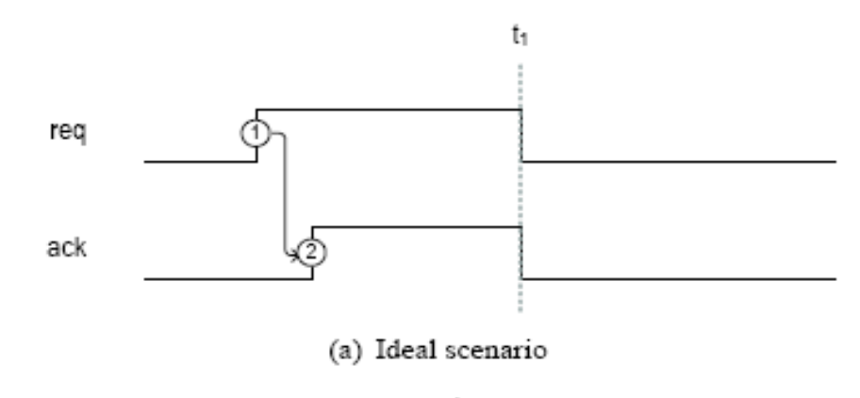
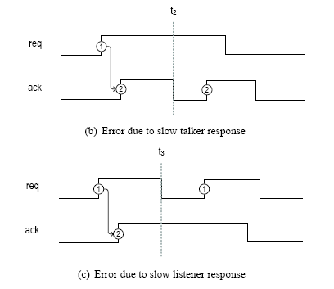
Can we remove the second part of handshaking?

Slide 63
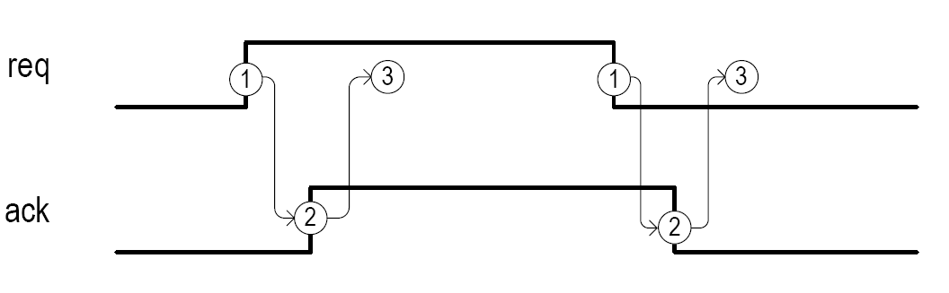
Two-phase handshaking protocol
  We can modify the 4-phase protocol so that talker/listener not returning to 0
  May not be proper for certain applications

Slide 64
6. Data transfer crossing clock domains

Slide 65
It is difficult to synchronize a multiple-bit signal (e.g., signal changes from 11 to 00)
Use req/ack and handshaking protocol to coordinate data transfer
  Only one signal needs to be synchronized in each domain
  All other signals are bundled as “data”

Slide 66
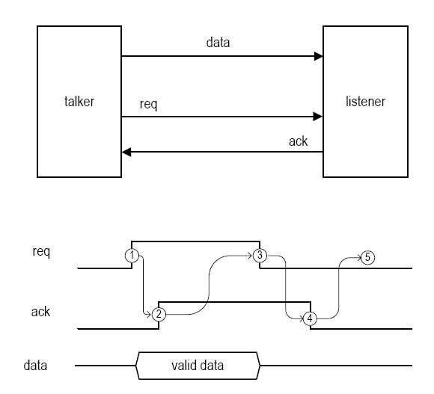
Push operation (talker sending data)
  Conceptual diagrams

Slide 67
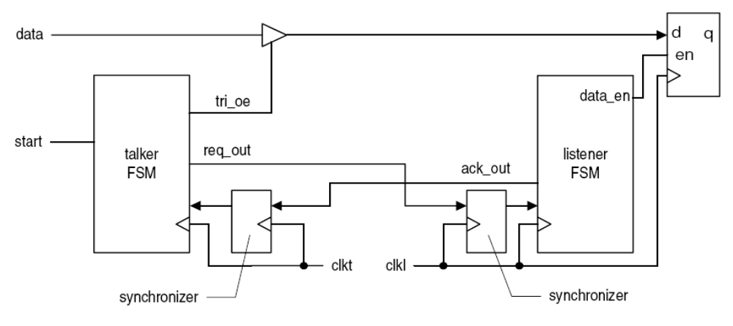
More detailed diagram
  Talker activates req_out and tri_en (i.e., placing data on data bus) at the same time.
  req_out is delayed one or two clocks when synchronized in listener
  data is stabilized when data_en is asserted (i.e., no timing violation)

Slide 68
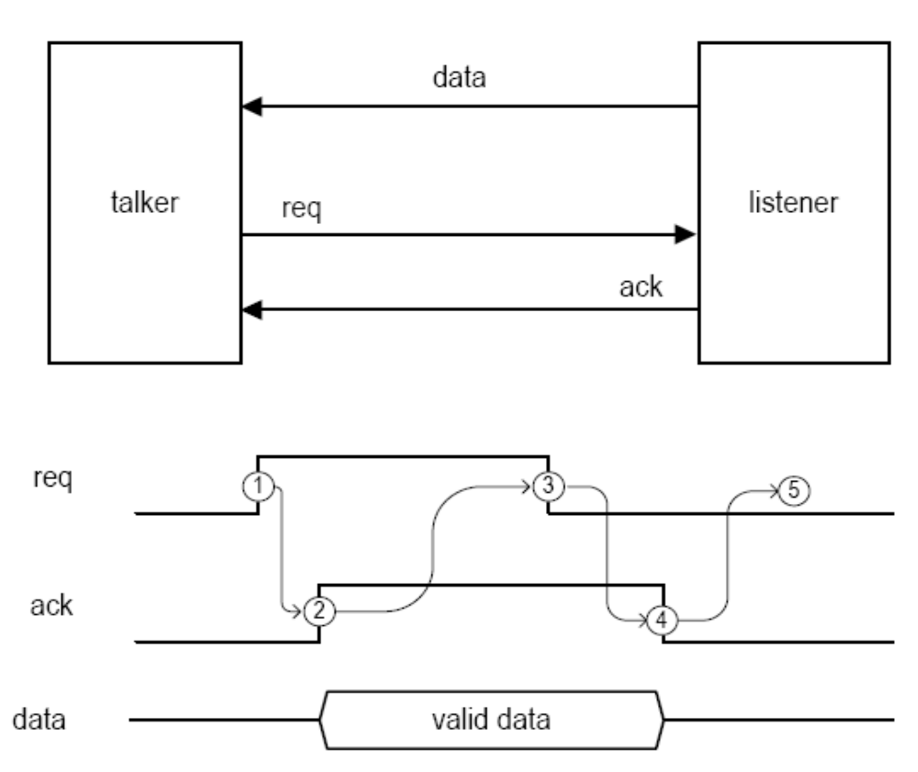

Slide 69
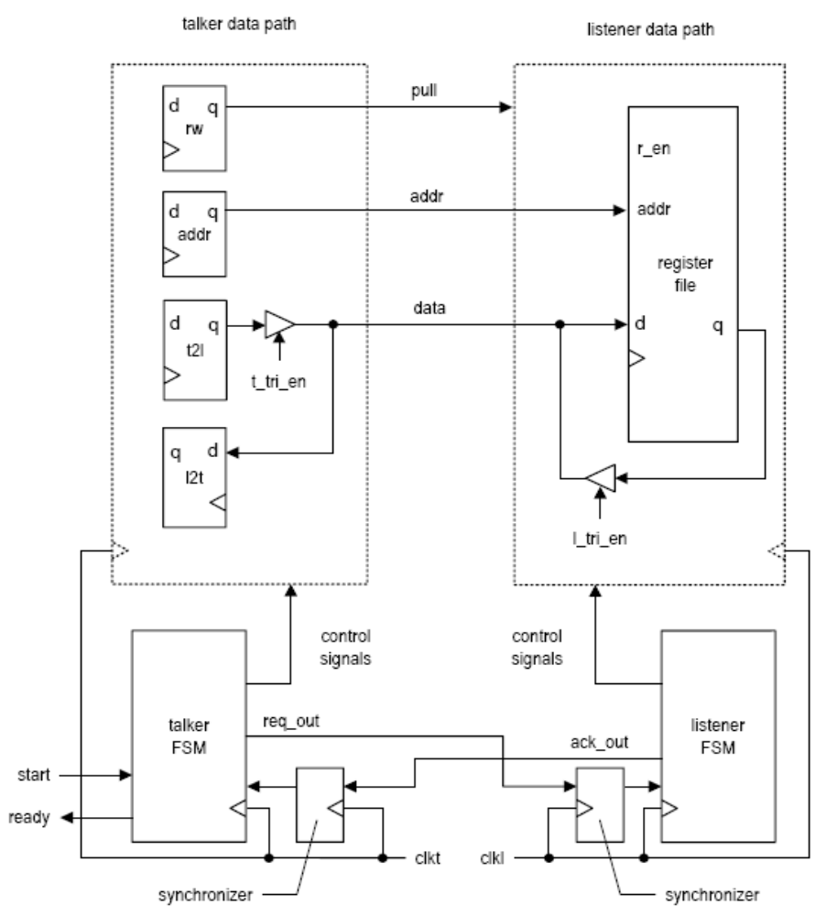
Bidirectional operation is possible; e.g.,

Slide 70
Performance:
  How many clock cycle for one data transfer?
Other methods for data transfer
  FIFO (synchronization needed for empty and full status signal)
  Shared memory (synchronization needed for arbitration circuit)
  Dual-port memory (meta-stable condition may occur in the internal arbitration circuit)

Slide 71
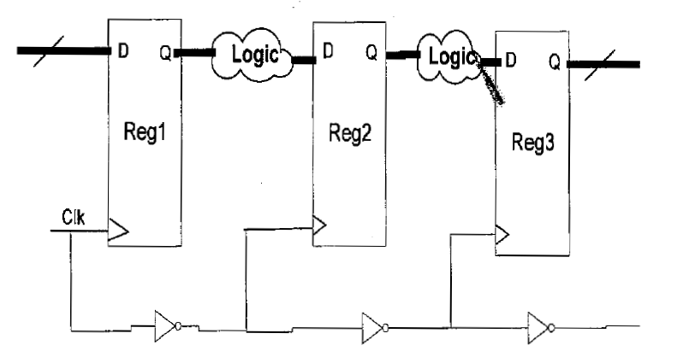
Domino Logic

Slide 72
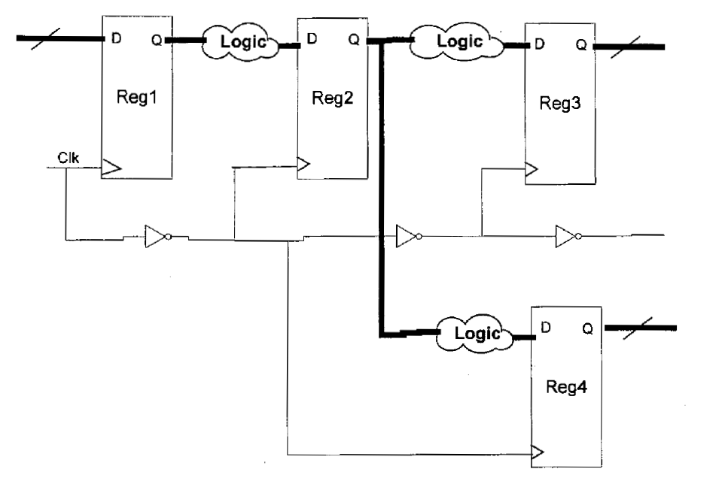
What if you have this topology?

Slide 73
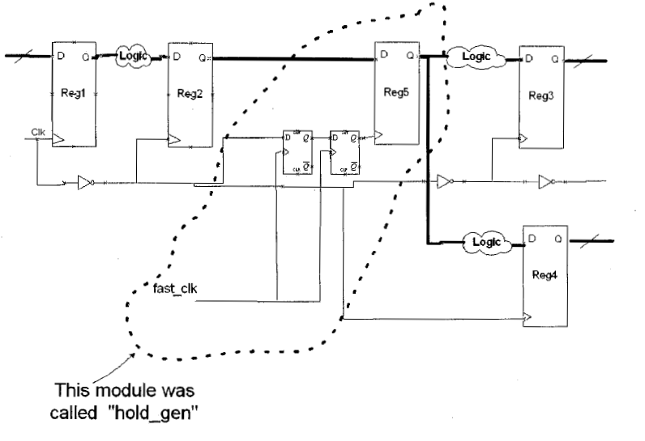
Solution: Generate hold time

Slide 74
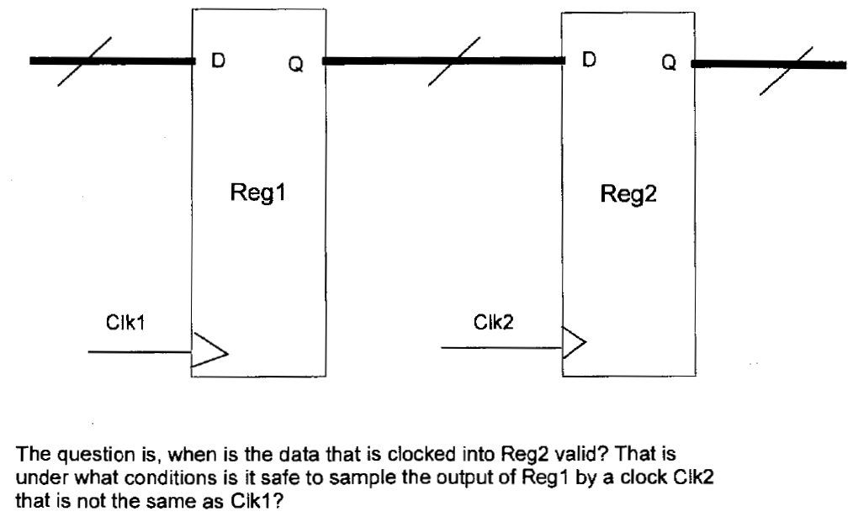
Moving signals between clock domains

Slide 75
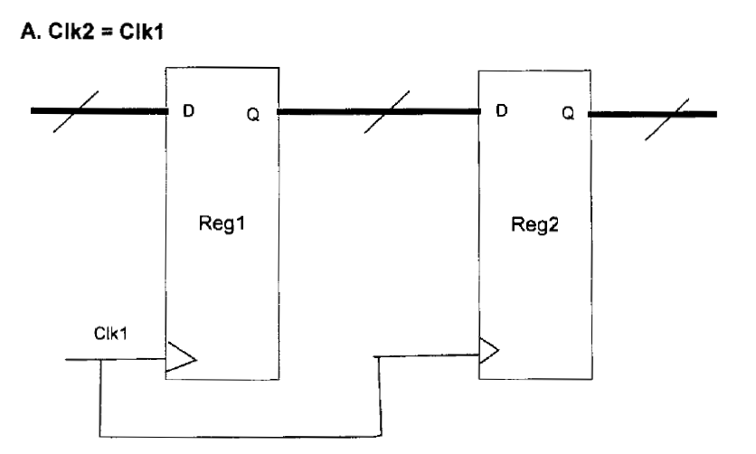
Same clock (trivial)

Slide 76
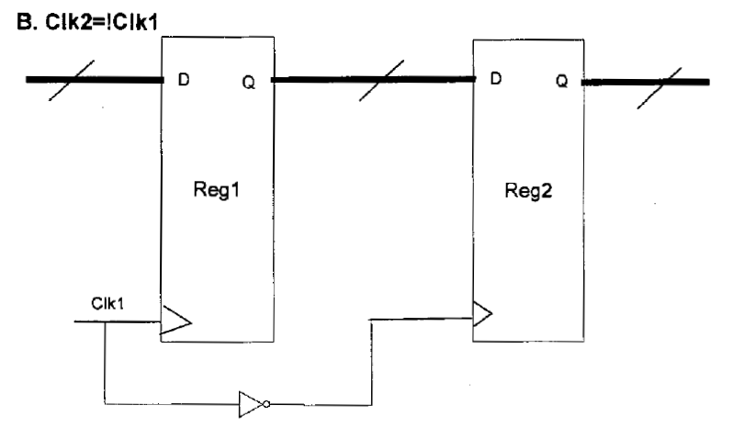
Inverted Clock

Slide 77
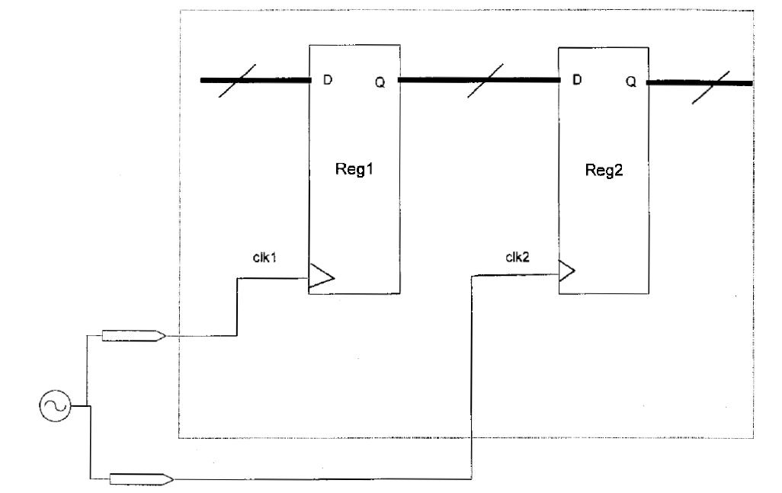
Same clock, different inputs

Slide 78
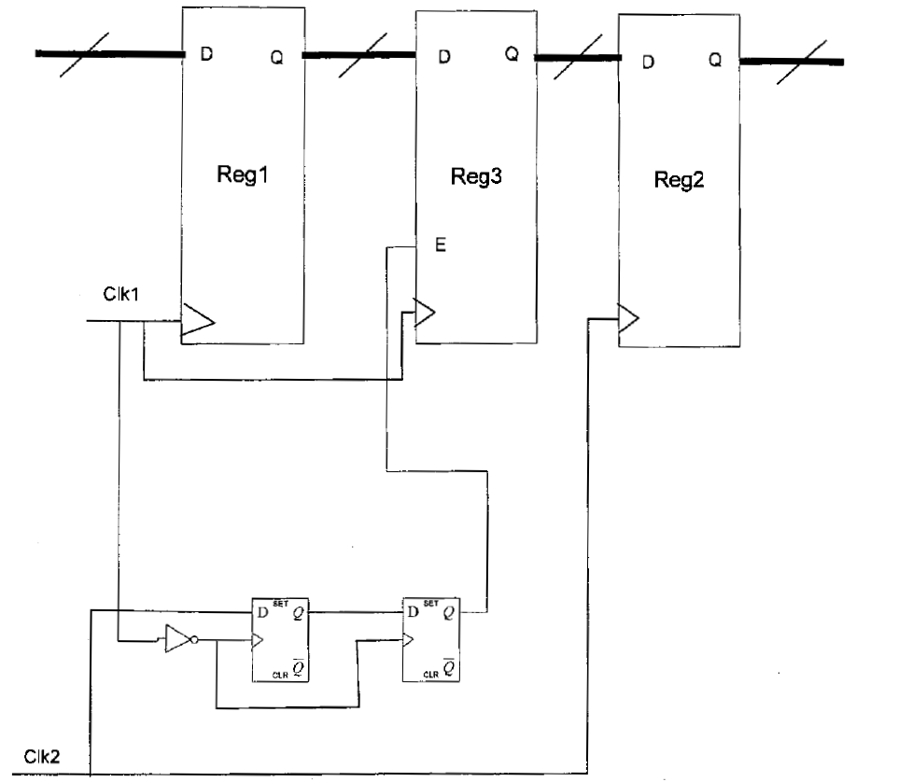
Moving data from fast Clk1 to slower Clk2

Slide 79
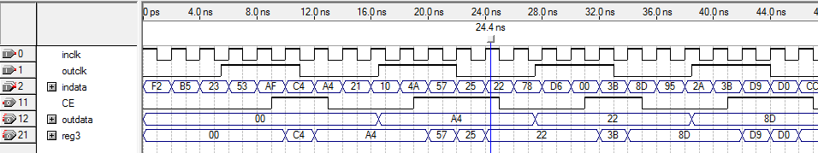
Moving data from fast Clk1 to slower Clk2

Slide 80

Moving data from Slow Clk1 to Faster Clk2

Slide 81

Moving data from Slow Clk1 to Faster Clk2

Slide 82

Routing Delays and Fanout

Slide 83
Fanout
The more fanout the circuit has, the more capacitance its output sees
Therefore, the higher the fanout, the slower the circuit
You can set the max allowable fanout in the compiler settings
If there is too much fanout, the compile will replicate the logic and divide up the fanout between the original and replicated logic
The price you pay is the replicated logic

Slide 84


Debouncing
Debounce problem: When switch is being depressed, the contact is open and closed many times before fully closed. Can be solved/mitigated in analog ways
Problem:
Many pulses (rising edges)
Voltage
at p0.3
3.3V
Without C3
With C3
3.3V
Time

Slide 85

Debouncer
If not mitigated via analog means, Capacitance in the button and contacts “bouncing” causes spurs that cause false positives. A debouncing circuit removes these spurs.

Slide 86

Debouncer
When the first change is detected, we ignore all subsequent changes for some period of time, preferably until all of the bouncing would have occurred. This is usually on the order of ms.

Slide 87
Debouncer – usually an FSM
reset
Debouncer
output
input
clk

Slide 88
Debouncer FSM
See Chu 5.3.2 and 6.2.1 for debouncing FSMs
Careful: Chu's circuits have glitches! You need to put a register on the output of those FSMs
It doesn't make sense to debounce a signal only to insert glitches!!!

Slide 89
Summary
Clock crossing and clock domains are a very big topic in digital design
If we neglect to properly address this issue, we will have effects of metastability, corrupted data, illegal FSM states, and unpredictable behaviour of our circuit
Debouncing of analog signals can be done in the analog domain. If done digitally, in general needs to be done via an FSM since the duration of the bounce is very long

